Slide 1

Leadership term project
Submitted to:
Ma’am Rizwana
Group Members:
Hamza Farooq [2016-CS-122]
Sana Masood [2016-CS-153]
Komal shehzadi [2016-CS-178]
zoha Rasheed [2016-CS-374]

Slide 2

What is covid-19?
Covid-19 is abbreviated from Coronavirus Disease 2019.
Coronaviruses are a group of related RNA viruses.
In humans, these viruses cause respiratory tract infections that can range from mild to lethal.
It is a pneumonia-like disease with symptoms including fever, dry cough and shortness of breath.
Around eight out of every 10 people with COVID­-19 will have mild symptoms. Around one in six people will become severely ill and need hospital care.

Slide 3

Origin of covid-19
In late 2019 someone at the now world-famous Huanan seafood market in Wuhan was infected with a virus from an animal.
The disease is caused by a new coronavirus, named SARS-CoV-2, that is similar to the viruses that causes Severe Acute Respiratory Syndrome (SARS).
Most young people and old people are the most vulnerable towards Covid-19 as immunity level is low in them.
A patient recovered from Covid-19 can donate blood plasma to other similar patients to increase the chances of being recovered.

Slide 4

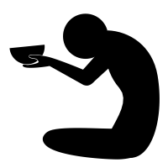
Poverty and economic loss due to lockdown
The great lockdown is saving lives while increasing poverty and hunger globally.
The great lockdown, being what it is, has shut down economic production from manufacturing to services, affecting businesses large and small.
As businesses closed their doors and factories shut their gates, unemployment surged.
Covid-19 forecast to render 18.5 million jobless Pakistanis that will increase the current unemployment rate that is 3.02 by 0.6.
A few business enterprises related to food and other life essentials have not shut their doors completely, causing great fluctuations in the stock market.

Slide 5
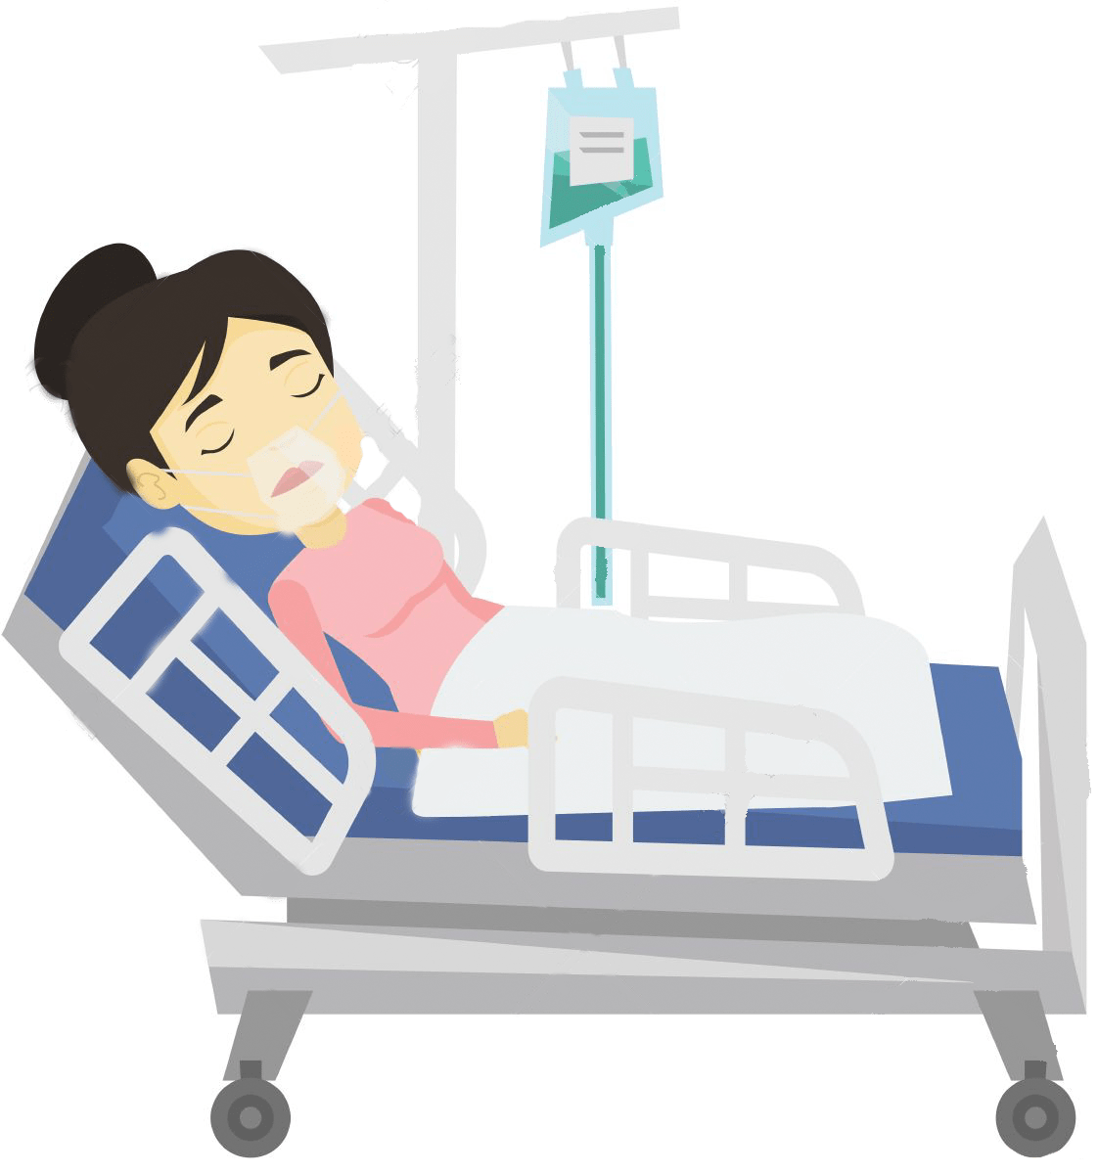
covid-19 cases in Pakistan
Up to 14 June, 2020 confirmed cases are 139,000 from which 51,735 recovered and 2,632 died.
50,087 are from Punjab, 49,256 from Sindh, 16,415 from Khyber Pakhtunkhwa, 7,866 from Baluchistan.
Pakistan’s testing capacity has been increased from 30,000 to 280,000 and would be further enhanced to 900,000.
National Disaster Management Authority (NDMA) works with National Institute of Wealth (NIW) to rise the current number of coronavirus testing laboratories

Slide 6
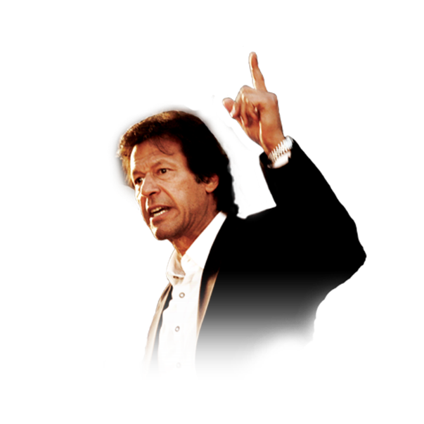
Campaign lead by prime minister. Imran khan
Imran Khan addresses his nation after every specified intervals in order to update with the scenarios Pakistan is facing these days. He motivated the public to stay calm, determined and protective from the coronavirus pandemic.
The total number of quarantines and isolation centers is raised up to 23,557 in 139 districts of Pakistan.
The Government of Pakistan established Covid-19 relief fund to receive donations for the welfare of publics.
The Central Emergency Relief fund (CERF) has allocated $60 million to global response plan for Covid-19.

Slide 7
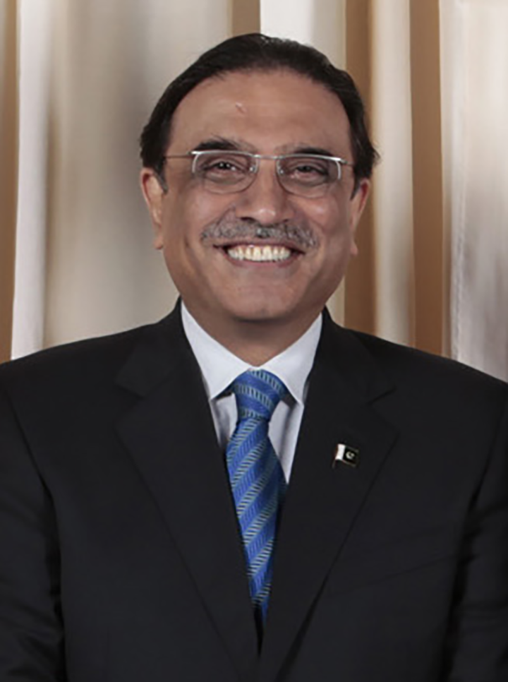
Asif Ali Zardari
Asif Ali Zardari is a Pakistani politician who is the president of Pakistan Peoples Party Parliamentarians and was the co-chairperson of Pakistan People's Party.
Strengths | Weaknesses
Party’s worthwhile name | Corruption
Support of people after death of his wife | Lack of credibility
 | Dependent Governance
 | No independent decision making

Slide 8
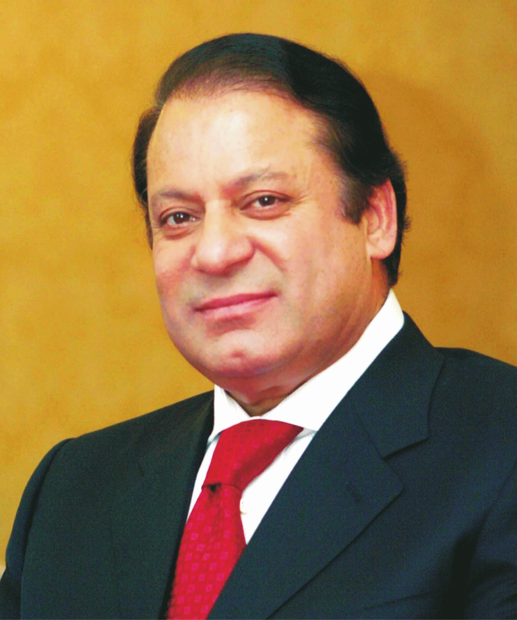
Mian Muhammad Nawaz Sharif
Mian Muhammad Nawaz Sharif is a Pakistani businessman and politician who served as the prime minister of Pakistan for three non-consecutive terms. He is the President of Pakistan Muslim League (N).
Strengths | Weaknesses
Persuasion skills | Dependent governance
Support of people | Lack of credibility
Party’s worthwhile name | Panama Cases
 | Corruption via steel mills

Slide 9
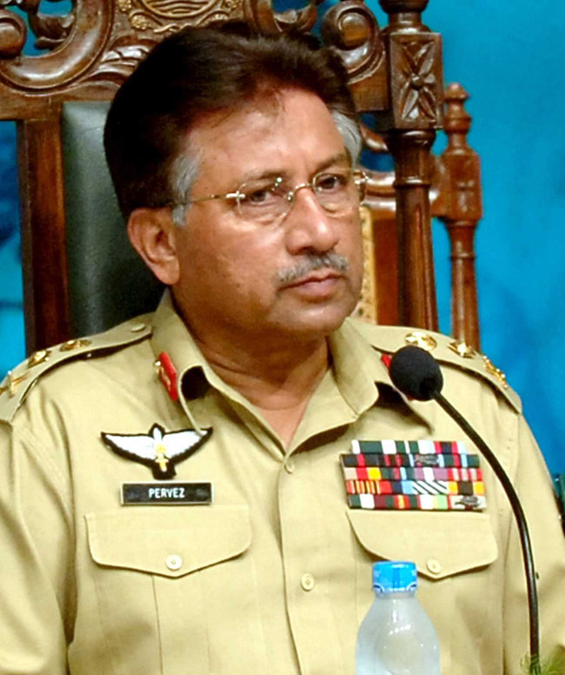
Pervez Musharraf
Pervez Musharraf is a Pakistani former four-star general and politician who became the tenth president of Pakistan. He held the presidency from 2001 until 2008.
Strengths | Weaknesses
Persuasion skills | Unable to manage all the scenarios
Support of people | Way too confident about himself
Former general | A little egocentric which turned into his exile
Holds degree of LLB
Many countrywide reforms

Slide 10
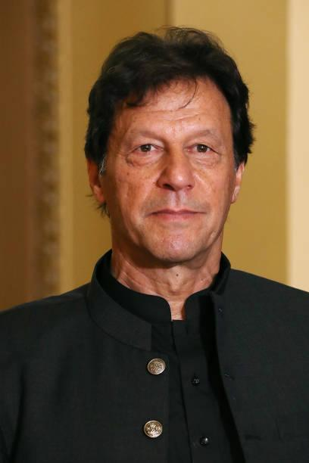
Imran Khan
Imran Ahmed Khan Niazi is the 22nd and current Prime Minister of Pakistan and the chairman of the Pakistan Tehreek-e-Insaf (PTI). Before entering politics, Khan was an international cricketer and captain of the Pakistan national cricket team, which he led to victory in the 1992 Cricket World Cup.
Strengths | Weaknesses
Persuasion skills | Uses foul language
Addresses the common issues by himself | Too much competitive
Looks at all sides of a story | Way too much confident
Independent decision making | Less outcomes
 | Lack of credibility

Slide 11
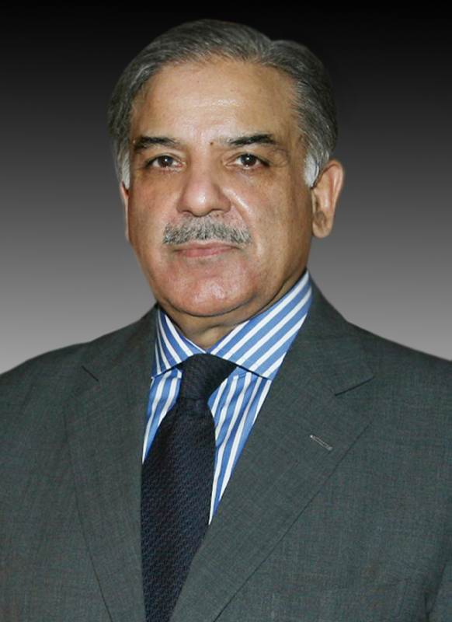
Shahbaz sharif
Mian Muhammad Shehbaz Sharif is a Pakistani politician who is the current Leader of the Opposition in the National Assembly of Pakistan, in office since 20 August 2018. Previously, he has served as the Chief Minister of Punjab three times in his political career making him the longest serving Chief Minister of Punjab.
Strengths | Weaknesses
Credibility among the people of Punjab especially Lahore in past | Dependent governance
His different schemes were a reason that people trusted him | No independent decision making
Famous among students because of his reward giving schemes | Lack of credibility
 | Corruption
 | Panama Cases

Slide 12
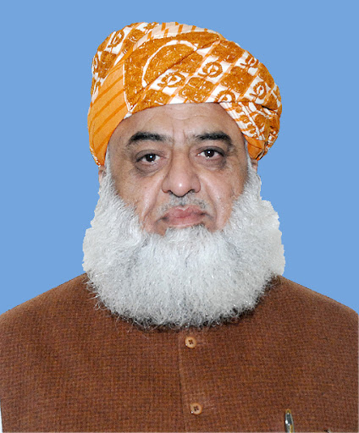
molana fazal ur rehman
Fazal-ur-Rehman is a hard-line, right-wing Pakistani politician and current president of Jamiat Ulema-e-Islam (F) (JUI-F) and Assembly of Islamic Scholars. Rehman was a member of the National Assembly between 1988 and May 2018 and previously served as Leader of the Opposition from 2004 to 2007.
Strengths | Weaknesses
Know to be religious leader and politician as well | Lack of persuasion skills
Long term benefit due to commitment from his party | Lack of credibility
 | Corruption
 | Mostly creating riot among people

Slide 13


Corruption and its impact on society
Corruption is a much-practiced evil from which originates countless misdemeanors.
It can rightly be asserted that corruption acts like a “wellhead” for other malpractices which in aftermath, destroys the fabric of society.
Unfortunately, Pakistan is replete with these all-too-often corrupt practices. Muhammad Ali Jinnah, our founder, was desirous of foundering a corruption-free Pakistan where law would prevail over all.
However, his dream was thrown to wolves highhandedly by power-brokers and Pakistan was acutely exposed to chronic waves of corruption.

Slide 14

Continued…
the social evil such as corruption helped to hold a defective system in place which has been paralyzing the existence of merit since independence.
It is extremely difficult to ascertain the exact causes yet according to a Perception Survey carried out by Transparency International Pakistan, the table below holds Survey on Causes of Corruption.
Lack of Accountability | 31.68%
Low Salaries | 16.54%
Monopoly of Power | 16.43%
Discretionary Power | 12.61%
Lack of Transparency | 9.97%
Power of influential people | 4.59%
Red Tapism | 4.28%
Others | 4.9%

Slide 15

Efforts to curb corruption
Corruption can be curbed or limited through the presence of a monitor or a monitoring process.
The 1st serious attempt to fight corruption at national level was witnessed during the caretaker period after the dismissal of 2nd Benazir government in November 1996 when President Farooq Leghari established Ehtsab Commission.
The army government of 1999 started accountability with a lot of fanfare. It established National Accountability Bureau (NAB).
Some new systems were introduced for improving the public sector procurement and a whole new standard operating procedure (SOP).

Slide 16
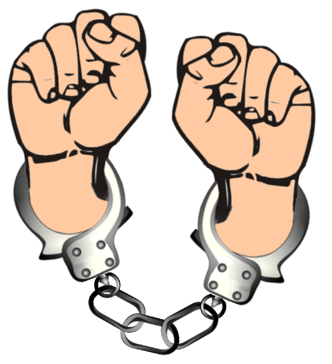
Steps to Curtail Corruption in Pakistan
“What kind of Pakistan do we want for our children?”
First, young people must lead change. Young Pakistanis are globalized, energized and full of ideas. We need to build an ecosystem to support these young change-makers - mentorship, opportunities, collaborative spaces and communities. They need support over time to sustain the change they want to see. Their creativity tends to exist in pockets and despite some recent mobilization politically, is largely delinked from policymaking.
Second, this is about more than creating organizations and enforcing rules. means Pakistan must think now about a long-term process to shift mindsets through investing heavily in civic education, leadership programs and values-based networks. Organizations like the Atlantic Council and the British Council are doing a great job, but there is much more to do

Slide 17
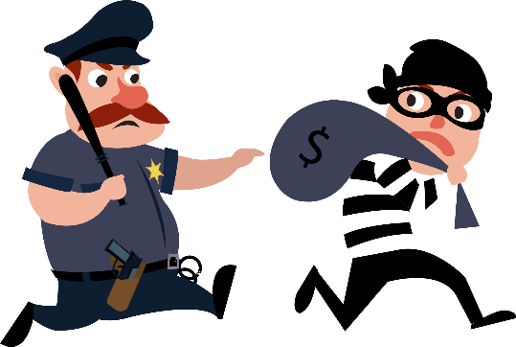
Continued…
Third, creativity is essential to fighting corruption because many stakeholders in the existing system are resistant to change. ICT collaboratives like the Technology for the People Initiative, the potential intersections of innovation and integrity in Pakistan are easy to find.
Fourth, bring in the private sector as a key driver of change. We must support driving the Open Government Partnership efforts in Pakistan and collaboratives like Open Lahore and CIPE are working to improve standards of transparency
Finally, accountability requires a positive narrative that Pakistanis can buy in to and mobilize behind. Pointing fingers and shouting loudly at law-breakers is an easy way to vent some frustration.

Slide 18

REMEDIES FOR COVID-19
Low budget: The federal government has prepared draft for Rs7,570 billion federal budget 2010-21. Rs1,000 billion is also expected to be allocated for dealing with coronavirus pandemic and for providing relief to the business community.
Disobedient Public: Public should be aware enough of all the outcomes they are facing or that they should keep in their mind that the whole world is facing economic loss due to COVID-19. If they want to lift lockdown as soon as possible they should maintain integrity with all the SOP provided to them.
Internet unavailability: HEC should make proper guidelines for institutes for carrying out online learning mechanism. Internet facility should be made possible for all the students by all means.

Slide 19
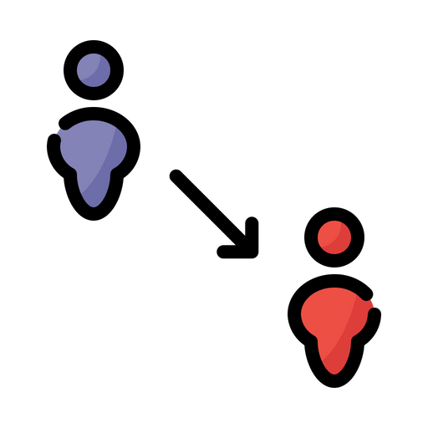
Continued…
Social Contact : Proper slots for people should be made in halls, super markets, grocery stores. Mosques. And all other public places so that violation of rules decreases.
Exposure of face: Compulsion must be made for wearing masks and gloves in all the public gatherings or places else fine will be charged.
Unavailability of isolation wards: Isolation wards must be increased so that infected people no longer affect the people and in this way total number of cases can be decreased per day.
Lack of ventilators: Instead of establishing taxes on imports and exports, Money should be spent in buying extra ventilators for patients so that they no longer suffocate the mselves to death.

Slide 20

Continued…
Less surgical equipment: Kits to doctors and other co-workers must be provided, because they are real heroes who are dealing with COVID patients. Doctors, nurses, pharmacists and lab technicians are priceless assets of the country against deadly viruses.
Social gatherings: Social gatherings must not be done unless it is made sure that no person is infected with COVID-19.
Unhygienic environment: Proper hygiene and cleanliness must be maintained in order to keep themselves preventive towards this virus.

Slide 21

Conclusion and Recommendations
To stay safe is to safe lives.
Keep your mouth tight and marked, just kill the demon to heal the earth, the coronavirus.
Power does not corrupt. Fear corrupts… Perhaps the fear of a loss of power.
Corrupt politicians make the other ten percent look bad.
The world needs huge positive energy to fight against the negative forces. Go to the center of your inner begin and generate that positive energy for the welfare of the humanity.
Focus on an ocean of positives, not a puddle of negatives.

Slide 22


